Slide 1


An Integrated Approach for Visualizing Student Activity During Distance Education
Michalis Kontos
Summer Intern at CYENS CoE
kontosmichalis24@gmail.com
© CYENS Centre of Excellence

Slide 2


Introduction
Popularity of distance learning
Use of camera leads to privacy issues
In many countries, camera is forbidden during teleconferencing
No optical contact between teacher and students
Students tend to lose concentration
An Integrated Approach for Visualizing Student Activity During Distance Education
© CYENS Centre of Excellence

Slide 3
Introduction
Aim:
Provide a system that allows educators to visualize students' actions and get informed about their behavior without having access to video input from them
An Integrated Approach for Visualizing Student Activity During Distance Education
© CYENS Centre of Excellence

Slide 4
Related work
Human Activity Recognition [1]
Steps taken:
Data preprocessing – elimination of irrelevant information and noisy data
Data augmentation – need for large amount of data
Feature extraction – extract characteristics from a face, decreases dimensionality
Feature selection – assign ranks and eliminate bottom ones
Classification
An Integrated Approach for Visualizing Student Activity During Distance Education
Snehita et al, 2021
© CYENS Centre of Excellence

Slide 5
Related work
Facial Expression Recognition [2]
Involves computer vision, machine learning, behavioral sciences
Academic vs basic emotions
VGG15 CNN architecture
Students’ attentiveness during tele-education [3]
Faster R-CNN vs SqueezeNet vs GoogleNet vs Inception-v3
2. Weighang et al 2021
3. Dimitriadou et al, 2022
An Integrated Approach for Visualizing Student Activity During Distance Education
© CYENS Centre of Excellence

Slide 6
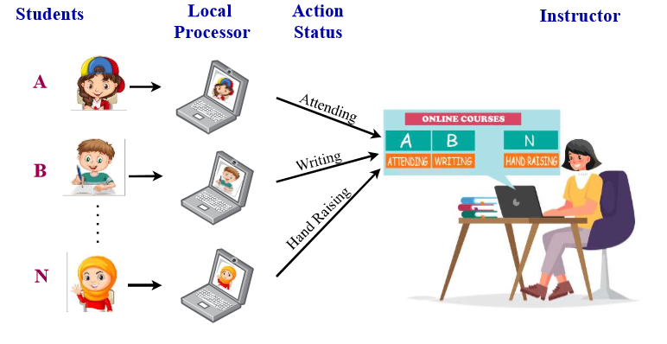
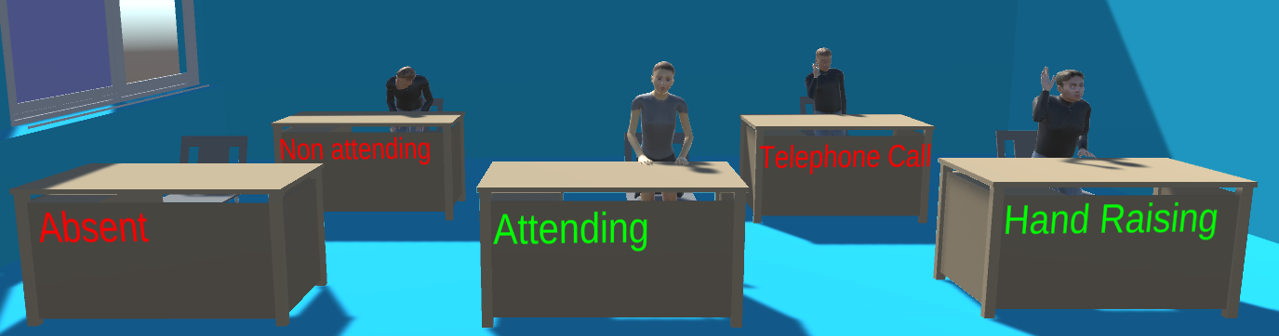
System Overview
An Integrated Approach for Visualizing Student Activity During Distance Education
© CYENS Centre of Excellence

Slide 7
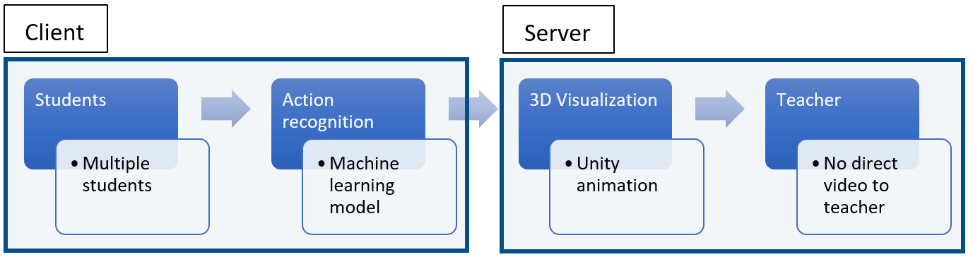
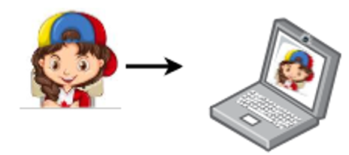
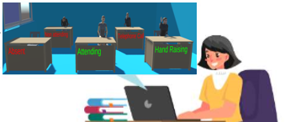
System Overview
An Integrated Approach for Visualizing Student Activity During Distance Education
© CYENS Centre of Excellence

Slide 8
Client
Machine learning model:
Based on the GoogleNet architecture
Consists of 27 layers including the pooling layers
Accuracy of 94.32% on previously unseen images
Computationally efficient with reduced error rate compared to competitors
An Integrated Approach for Visualizing Student Activity During Distance Education
© CYENS Centre of Excellence

Slide 9
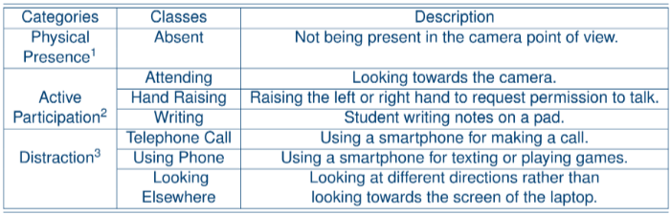
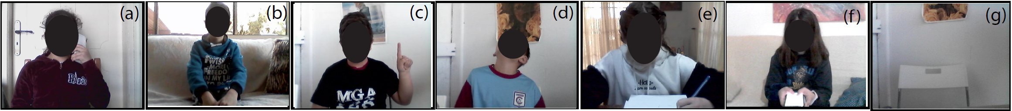
Actions classified
Telephone call
Attending
Hand raising
Looking elsewhere
Writing
Using phone
Absent
Raddon, 2006
Pratton and Hales, 1986
Baron,1986
An Integrated Approach for Visualizing Student Activity During Distance Education
© CYENS Centre of Excellence

Slide 10
Client
Features:
Can work as a standalone program or connected with the server
Requires an ID input from user
Uses a majority voting system to select most popular classification in a 10 seconds interval
An Integrated Approach for Visualizing Student Activity During Distance Education
© CYENS Centre of Excellence

Slide 11
Server
Features:
Listens for new connections
Creates a new thread for every client connected
Checks if the ID is valid
Outputs the message received into a log file
An Integrated Approach for Visualizing Student Activity During Distance Education
© CYENS Centre of Excellence

Slide 12
Server
Unity3d Animation:
3D Visualization of students’ actions
An Integrated Approach for Visualizing Student Activity During Distance Education
© CYENS Centre of Excellence

Slide 13
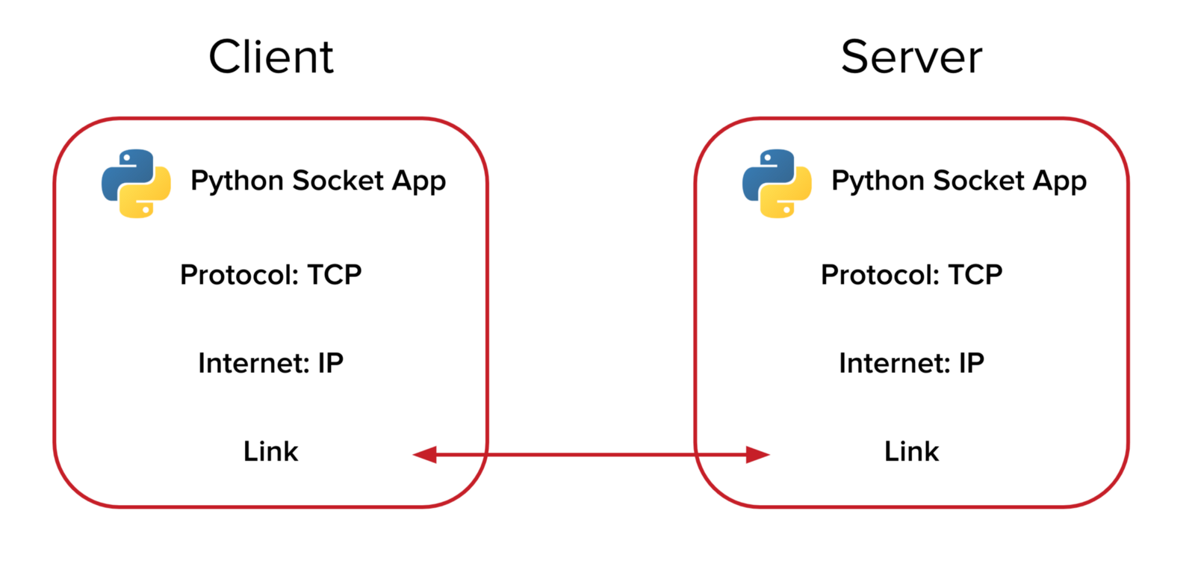
Communication Server-Client
Python sockets
Transmission Control Protocol (TCP)
Reliable and in-order data delivery
UTF-8 encoded messages
An Integrated Approach for Visualizing Student Activity During Distance Education
© CYENS Centre of Excellence

Slide 14
Synchronization Server-Client
Client sends output to server
Server keeps track which client send the classification
Server writes classification in log file
Unity reads log file and performs animation
Client performs classifications for 10 seconds
An Integrated Approach for Visualizing Student Activity During Distance Education
© CYENS Centre of Excellence

Slide 15
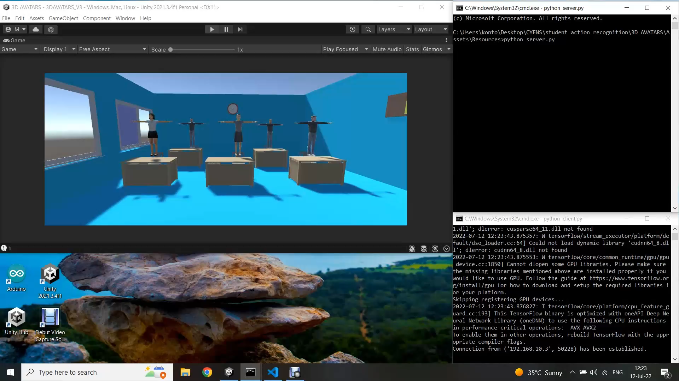
Demonstration
An Integrated Approach for Visualizing Student Activity During Distance Education
© CYENS Centre of Excellence

Slide 16
Conclusion
Presented a system that allows teachers to visualize student actions during distance learning without optical contact with students
Early results and feedback prove the promise of this approach
An Integrated Approach for Visualizing Student Activity During Distance Education
© CYENS Centre of Excellence

Slide 17
Future work
Improve response time
Comprehensive evaluation
Add the ability to recognize additional actions and emotions
Online multi-user virtual space with Virtual Reality equipment
An Integrated Approach for Visualizing Student Activity During Distance Education
© CYENS Centre of Excellence

Slide 18
Thank you!
Any Questions?
An Integrated Approach for Visualizing Student Activity During Distance Education
© CYENS Centre of Excellence

